Slide 1
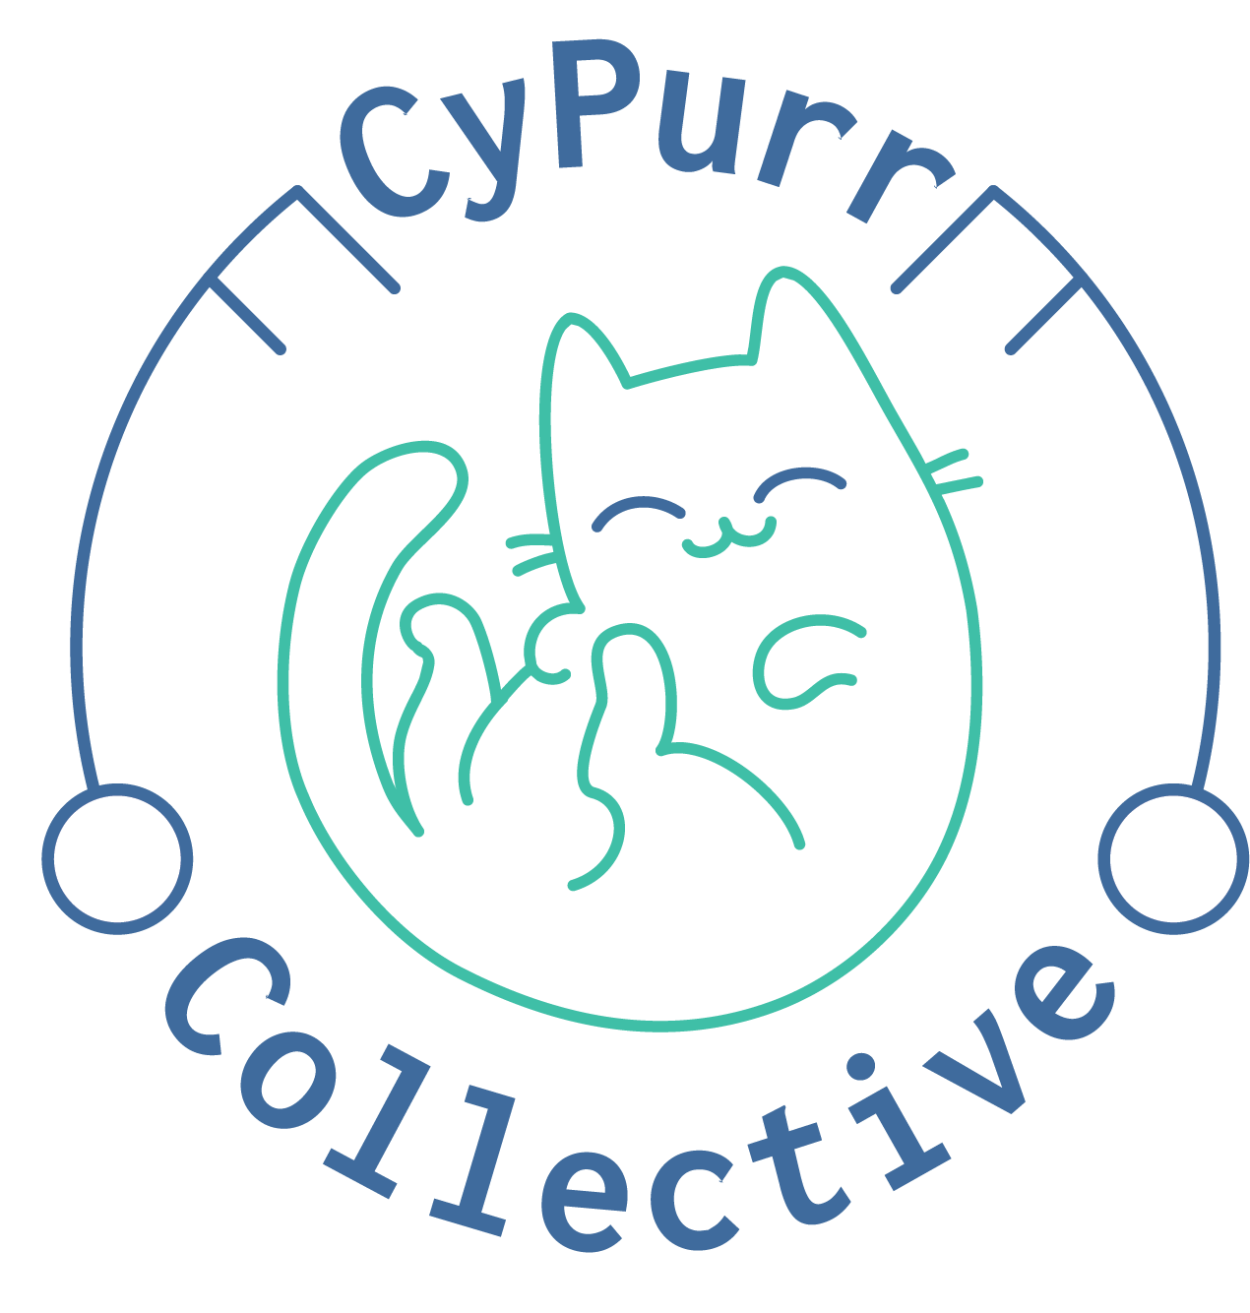
How to Stop A Bully
Threat Modeling in the Age of Cyber Harassment
Free University
3/24/18

Slide 2

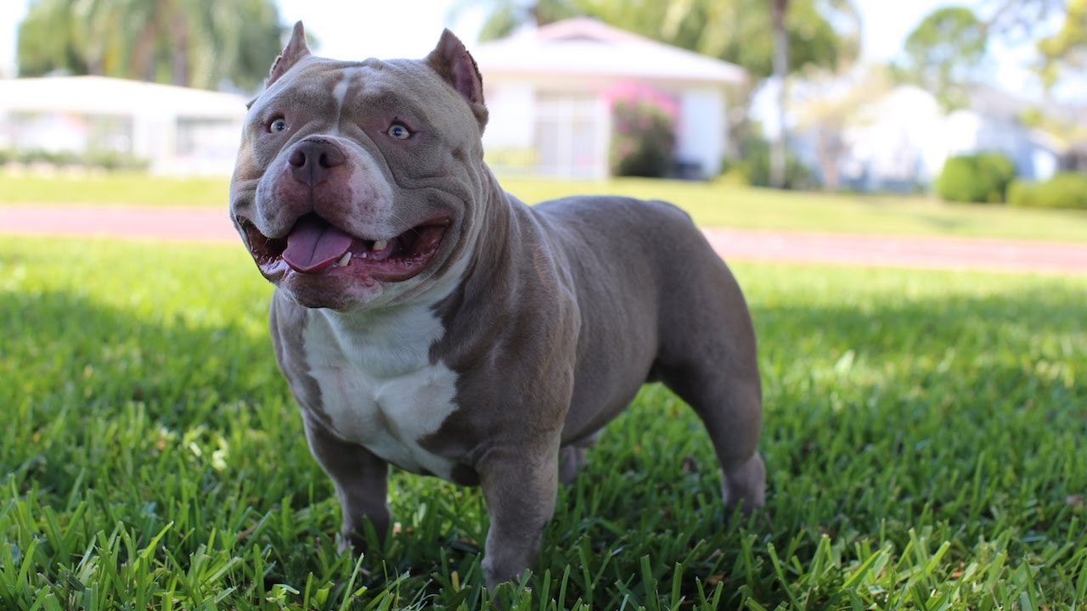
Overview
Intros
Levels of Prevention
Threat Modeling
Ways To Reduce Harm Before
Ways to Reduce Harm After
Resources

Slide 3
Who are we? Who are you?
We are the…
The Cypurr Collective: A group of folks that organize cybersecurity workshops and socials, looking to spread knowledge and talk about privacy rights!
...and you are?
Name
Pronouns (i.e. he/him, she/her, they/them, ze/zer, etc)
In a few words, what brings you here today?

Slide 4
A few rules for this workshop …
Share the space!
Step Up Step Back: Ask a question, give a comment, leave room for others to speak
Stack!
Raise your hand and we will put you on the speaking queue
Saf(er) Space
We DO NOT tolerate language or behavior purposefully meant to demean or harm folks based on their identities
No one should be forced to discuss their own experience/threat model/situation
Consent: Ask before helping someone out, before taking their device
Photo/Video- No photo/video without asking!
Bonus Rule: Try not to invalidate experiences!

Slide 5
WHAT IS CYBER HARASSMENT?

Slide 6
Heart Mob Definition...
What is exactly is online harassment?
Online harassment includes a wide range of targeted behaviors including: threats, continued hateful messages, doxxing, DDoS attacks, swatting, defamation, and more. Online harassment can target (or come from) a group or individual and often has the expressed purpose of having the individual or group leave the internet, take down their content, or to dissuade them from publically having a point of view.
While there is space for debate and discussion online (as well as conflicting ideas!), what separates online harassment from healthy discourse is the focus on harm: including publishing personal information, sending threats with the intention to scare or harm, using discriminatory language against an individual, and even directly promoting harm against a person or organization. We believe in a free internet where individuals feel safe to connect and speak freely, regardless of their religion, identity, or political ideology.

Slide 7
Red Flags
Your partner frequently asks to see your computer or cell phone, or takes it.
Your partner demands passwords to your computer or cell phone.
Your partner wants login information for your email, banking, shopping, or social media accounts.
Your partner is known to be "good with computers" and handles your computer tasks.
Your partner gives you devices that they've set-up for you.
Your partner spends a significant amount of time on their computer and is unusually secretive about it.
Your partner makes vague references to activities or conversations they were not present for.
Your partner gets unexpectedly angry towards a person you've recently communicated with.
Your partner threatens to reveal embarrassing information about you.

Slide 8
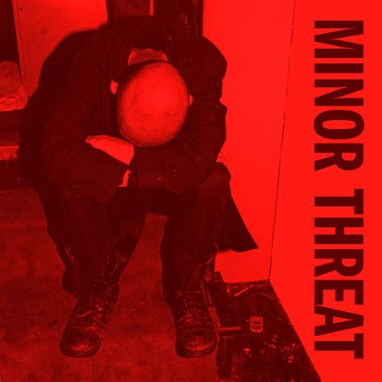
Intro to Threat Modeling
What Am I Protecting?
Who Am I Protecting it From?
How Likely is It That I Need to Protect It?
What Are The Consequences if I Fail?
What Am I Willing to Do To Protect It?

Slide 9
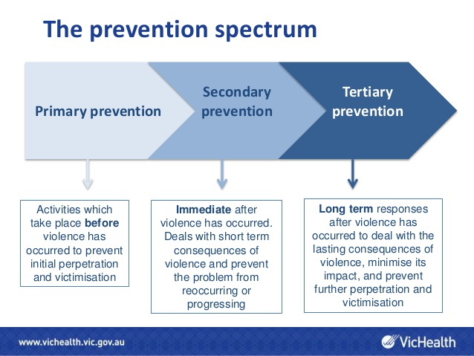

Slide 10

Ways To Reduce Harm Before (Primary Intervention)
Make A Plan (Threat Model)
Who Can Help Me?
What Can I Do?
Protect Passwords
Complicated Passwords
Password Managers
2FA
Twofactorauth.org
Phone Settings
GPS Location
Blocking
Private Browsing
Incognito Mode
Clear Cookies

Slide 11
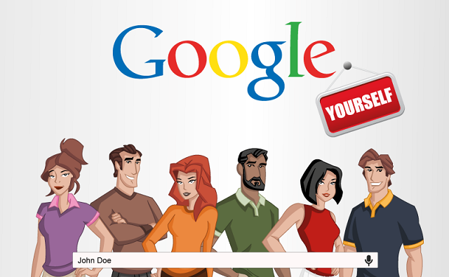
Ways To Reduce Harm Before (Primary Intervention)
Secure Social Media
FB, Twitter, Insta Privacy Settings
Back Up Data
Sending What to Who?
Secret Accounts
Public Computers
Payment
Google Yourself!
Data Brokers
Privacy Duck
WHOIS
Own A website?

Slide 12

Ways To Reduce Harm After (Tertiary Intervention)
Primary Intervention Tactics
Crisis Helpline
Crash Override
HeartMob
Privacy Duck
Report It
Collect Evidence
Change Passwords
Phone
Use Alternative Apps
Change Number?
Reinstall Phone

Slide 13
Resources
HackBlossom- https://hackblossom.org/domestic-violence/
Crash Override Network- http://www.crashoverridenetwork.com/
HeartMob- https://iheartmob.org/
Privacy Duck- https://www.privacyduck.com/
Without My Consent
Resist.Space- https://resist.space/
Other
Tactical Tech Collective- Holistic Security, Data Detox, My Shadow
Cypurr Collective- https://github.com/CyPurr-Collective/, Facebook
Cryptoparty.in

Slide 14


Slide 15

THANK YOU!

